Slide 1
Design of Everyday Things
lecture 2

Slide 2
Reading
Read chapter 1 of Design of Everyday Things
Don Norman

Slide 3
Design of Everyday Things
You should know the following after reading the first chapter.
Affordances
Conceptual Model
Making Things Visible
Natural Mapping
feedback

Slide 4


What can we do with this box???

Slide 5
Affordance
The relationship between an object and a person

Slide 6
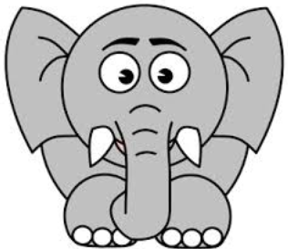
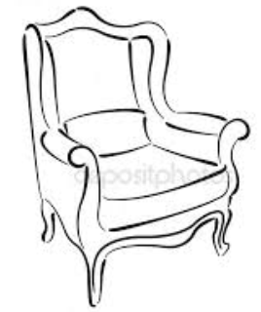

Slide 7
Affordance is jointly determined by the properties of the object as well as the person.

Slide 8
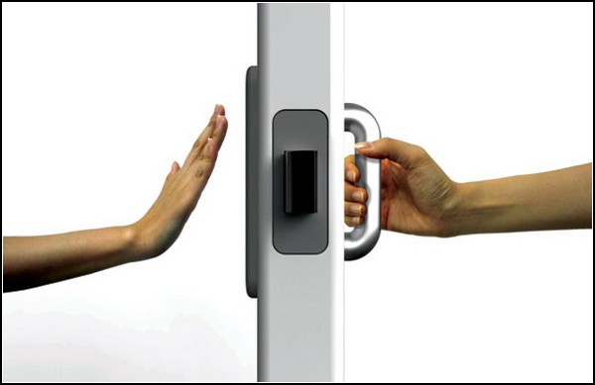
Don Norman’s Door Example
A plate naturally says “ push me” and a handle naturally says “pull me “

Slide 9
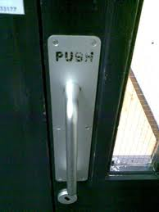
Don Norman’s Door Example
When Don Norman’s advice is not followed

Slide 10
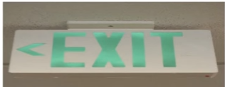
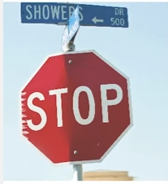
Signifiers
Signifiers are communication devices

Slide 11
Signifiers
When we first encounter a product we search for clues or a sign that help us understand what to do with a product.
Missing Signifiers
Watching a video on youtube how many ways can you start and stop it?
Do signifiers exist in each case?

Slide 12
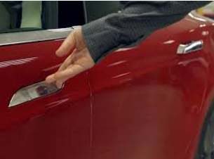
Signifier But Missing Affordance

Slide 13
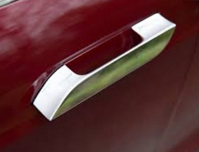
Signifier But Missing Affordance
Notes:
Tells you where the handle is but not what to do

Slide 14
Affordance vs Signifiers
Something can be an affordance or a signifier or both
or neither
Affordance are the possible actions an actor can take with an item in question
Signifiers are the signals conveyed to the person about the possible actions

Slide 15
Misleading Affordances or Signifiers
Fake security camera’s
Like the ones we have in class ☺
Pockets that are sewn shut

Slide 16
The three Models
Implementation Model
Mental Model (Conceptual Model)
Represented Model (System Image)

Slide 17
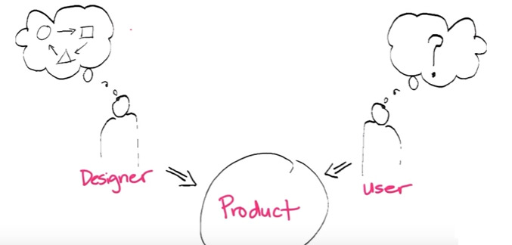

Slide 18
Implementation Model
The representation of how a machine actually works is called the Implementation model or the system model
In software it is much easier to design software that reflects the implementation model
But that results in complex design

Slide 19
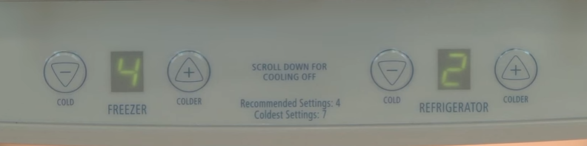
Conceptual Models

Slide 20
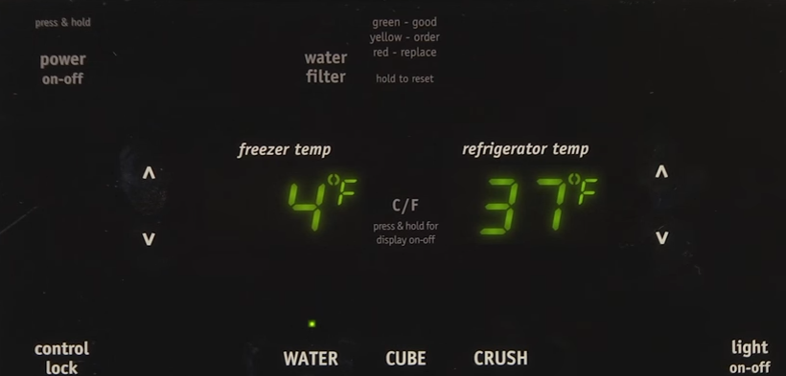
Conceptual Models

Slide 21
Conceptual Models
A conceptual model is an explanation (usually highly simplified) of how something works.
They might be learned from the product itself or from another person
They help people predict how a product would work and what to do incase something goes wrong.
It is the responsibility of the designer to help people develop a useful conceptual model.

Slide 22
Conceptual Models
People often have their own explanation of how things work
It may or may not be correct
For example mobile phones and landlines

Slide 23
Conceptual Models
mental models are in flux exactly because they're embedded in a brain rather than fixed in an external medium.
Additional experience with the system can change the model
Users might also update their mental models based on stimuli from elsewhere, such as talking to other users or even applying lessons from other systems.

Slide 24
Represented Models or System Image
How the designer choose to represent the applications working to the end user.
The closer the represented model is to the users mental model the easier the user will find the application to use.
An application represented model can and should be different from the implementation model.
Example Network Server

Slide 25
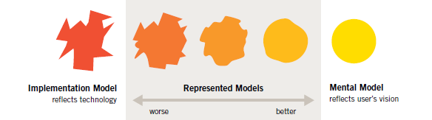

Slide 26
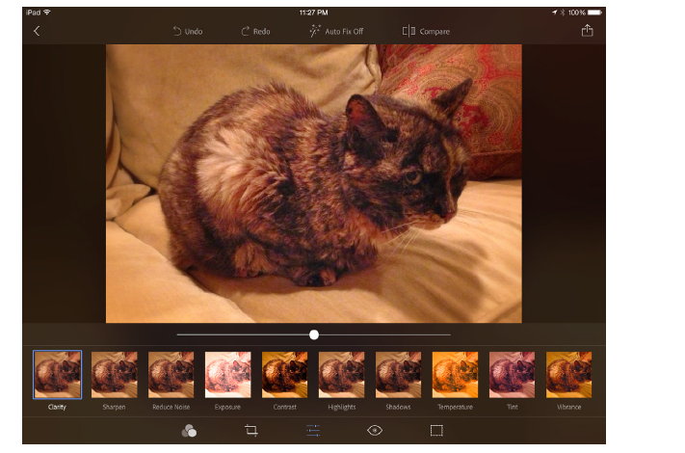

Slide 27
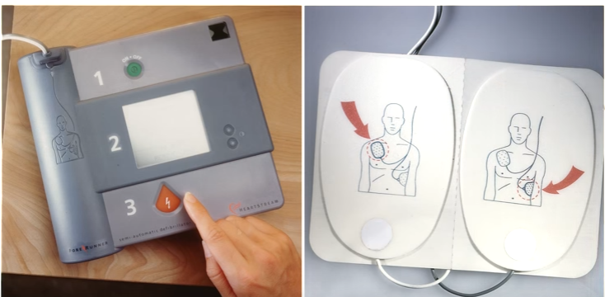
An example of a Good System Image

Slide 28

Important to understand difference between Goals and Tasks

Slide 29
Gulf of Evaluation And execution
Gulf of Execution
Discoverability
Gulf of Evaluation
Feed back

Slide 30
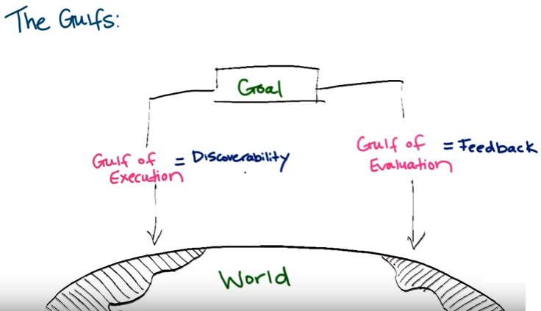
Gulf of Evaluation and Execution
Designers should reduce the gulf.

Slide 31
Gulf of Evaluation
Large gulf of evaluation: hourglass, spinning pinwheel, no details
Small gulf of evaluation: progress bar with listing of current file being copied, and estimated completion time

Slide 32
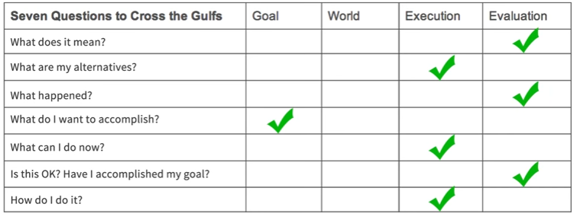
A user must be able to answer all these questions when using your product.

Slide 33
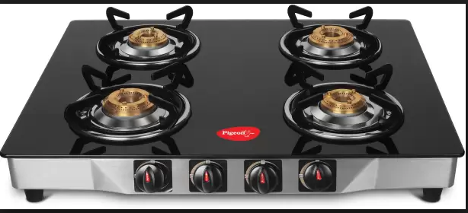
Natural Mapping

Slide 34
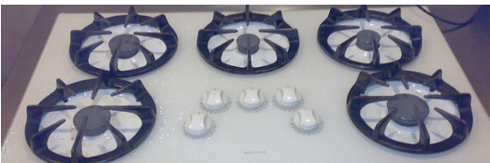
Natural Mapping

Slide 35
Natural Mapping
When you turn a wheel or push a button, you expect some effect, if the effect matches your expectation, the mapping is considered to be good.
Consider the gas stove in your home.
Does it use natural mapping?
They can match physical analogies or cultural
Consider the lock, unlock of old nokia phones
Complex input like pressing several buttons together in a certain order is not natural so we easily forget
In word ctlr + s other other short cuts
Which ones do you use?

Slide 36
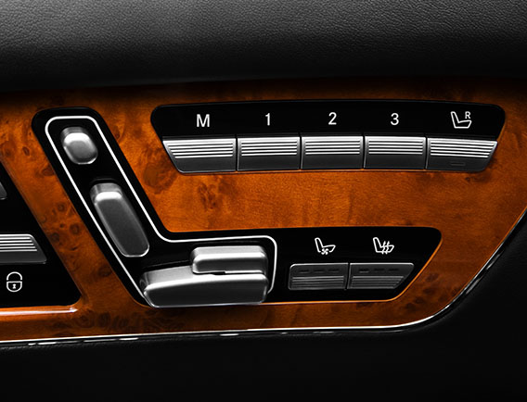
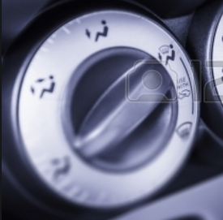
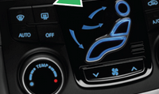
Natural mapping

Slide 37
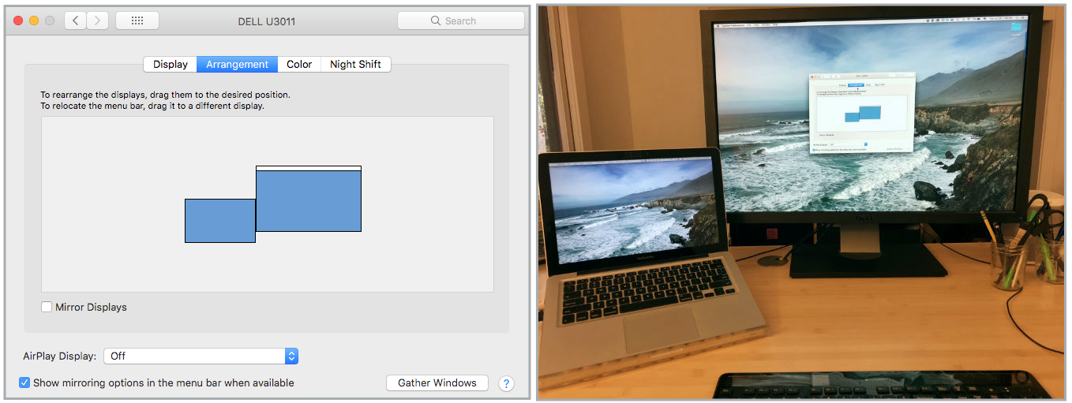
Natural Mapping

Slide 38

Types of Natural Mapping
Spatial Similarity
Example: Layout is similar to natural world
like on previous slide
Conceptual or metaphorical similarity
Example: “green is go” and “red is stop.”
Behavioral similarity
Example: “raise to wake” gesture.

Slide 39
Feedback
Providing feedback through different means doesn’t cost much but can increase customer satisfaction
What happens when you press a button on touch screen?
Inserting memory card or battery in a camera

Slide 40
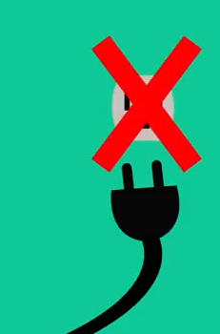
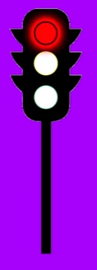
Constraints
Constraints are designed to limit the user to prevent an incorrect action from happening.
They can be:
Psychological: red light, warning signs
Physical: A road, path, barriers

Slide 41
